Slide 1
Monday, 11.16 and Tuesday, 11.17
PLEASE LEAVE YOUR ESSAY PREWRITE ON MY CART AND GRAB YOUR SPIRAL!

Slide 2
TODAY’S AGENDA
Night Overview
Timeline of events
Thematic Relevance
Pyramid of Hate
Introduction of Oppression Research Groups
Rights Ranking and Values Auction
Identity and Privilege Exploration
Propaganda Techniques and Examples
Analysis of propaganda posters from WWII

Slide 3
Holocaust – “Destruction by Fire”
Setting:
1939-1945
German-Occupied Europe
Goal of Nazi Germany:
Extermination of all Jews
Out of 8.3 million Jews, 6 million were killed
Of the 6 million, 1.5 were children
Other victims of the Holocaust:
Gypsies
Christians suspected of Jewish ancestry
Homosexuals
Handicapped
Anyone opposing the Nazis
Anyone considered inferior to the Aryan race

Slide 4
Nazi Germany and Anti-Jewish Policy
Between 1933 and 1938, nearly 150,000 Jews managed to leave Nazi Germany. The number represented approximately 30% of the total Jewish population.
In order for Jews to legally emigrate from Germany, they were required to have both German passports and visas permitting them to enter another country.
Most countries, however, had quotas that limited the number of immigrants allowed to enter and required that those entering were able to support themselves.
Very few countries admitted German-Jewish refugees, and after the Kristallnacht Pogrom, it became extremely difficult for Jews to leave Germany. Most of the Jews who fled Germany went to other European countries that were occupied by the Nazis months or a few years later.

Slide 5
Kristallnacht Pogrom
Rioters destroyed 267 synagogues throughout Germany, Austria, and the Sudetenland between Nov. 9 and 10, 1938. Many synagogues burned throughout the night, in full view of the public and of local firefighters, who had received orders to intervene only to prevent flames from spreading to nearby buildings. SA and Hitler Youth members across the country shattered the shop windows of an estimated 7,500 Jewish-owned commercial establishments, and looted their wares. Jewish cemeteries became a particular object of desecration in many regions.

Slide 6
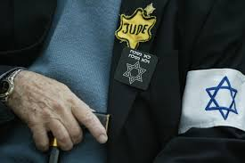
How the Holocaust Began
Centuries of Christian and anti-Semitism already existed
Hitler became dictator of Germany and began the war
Economic hardships in Germany were blamed on the Jews
WWII was used as an excuse to kill

Slide 7
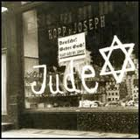
Initial Treatment of the Jews
Jewish businesses were boycotted and vandalized
Jews fired from jobs in government and universities
Jews lost citizenships and all rights
Synagogues were destroyed
Jews forbidden to intermarry with Germans
Jews evicted from their homes and forced to live in ghettos

Slide 8
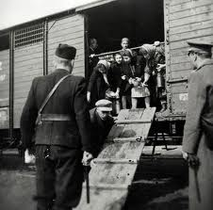
The Concentration Camps/Death Camps
Jews shipped from ghettos to camps in cattle wagons
Families separated immediately – husbands from wives, parents from children
Adults considered able were sent to work camps for heavy physical labor under brutal conditions
Those unfit for work were marched into what looked like bath houses under the pretext of taking a shower

Slide 9
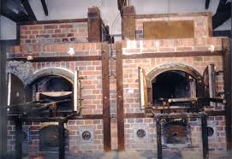
The Final Solution
Once Jews were packed into chambers, doors were locked
A gas called “Cyclon B” was dispersed through shower heads
The poison could asphyxiate about 2,000 children and adults within 20 minutes.
This method, repeated over and over again, resulted in deaths of approximately 4 million women and children in Auschwitz alone.
Bodies then burned in crematory

Slide 10
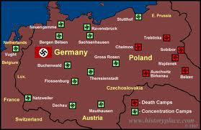
The End of the Holocaust
Germany defeated in May, 1945
Russians first discover physical evidence of Holocaust
Maidanek, then Auschwitz, Buchenwald, Bergen-Belsen, Dachau, Mauthausen

Slide 11
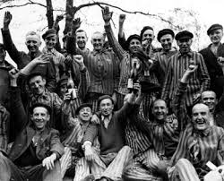
The Survivors
Most emigrated to Palestine (now Israel)
The State of Israel was established as a Jewish homeland in 1948
Others came to the US or any country that would accept them

Slide 12
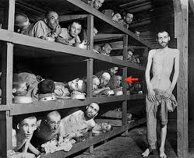
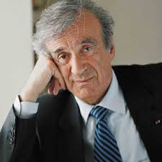
Elie Wiesel
Born in Transylvania in Hungary on September 30, 1928
Deported to a camp along with his family when he was 15
Survived 2 death camps
Came to US in 1956; became a professor in New York and Boston
Won Nobel Peace Prize in 1986

Slide 13
Thematic Connections to Consider
TOLERANCE AND ACCEPTANCE
PREJUDICE, BIGOTRY AND INTOLERANCE
COURAGE AND HEROISM
FAMILY
PROMISE/LEGACY
FATE VS. CHOICE
PEER PRESSURE
NATURE OF MAN
INTEGRITY
PERSONAL AND COLLECTIVE MORALITY
RESPONSIBILITY
APATHY VERSUS COMPASSION
PERSISTENCE
HOPE

Slide 14
Studying the Holocaust
Approaches:
Victims
Persecutors
Bystanders, everyday people
We will study the text through all of these perspectives.
What can the Holocaust teach us about today’s world?
People’s inhumanity to people
The survival of the human spirit
Taking action against injustices:
Challenges
Choices
Courage
Consequences

Slide 15
What Rights Do I Value Most? Complete the following in your spiral: Rank the following in order of importance to you (#1 = most important and #9 is least important). Explain your #1 ranking and your #9 ranking with at least 3 sentences.
Date/Marry whomever you choose
Go to a public school close to home
Live in a neighborhood of your choice
Swim and play in a public swimming pool or park
Vote
Eat what you want, according to taste, culture, and religious custom
Be able to own a pet
Leave your house whenever you choose
Shop at stores and businesses of your choosing

Slide 16
How Does Propaganda Work?
Repeats the same information over and over
Twists and exploits the truth
Appeals to people’s emotions
Gives the illusion that most people agree with the message
Talks to people in their own language
Uses accessible media (newspaper, radio)
As we view the following propaganda posters, consider:
What statement is the photo or caricature making?
How is the example exploiting the already existing anti-Semitic attitudes in Germany?
How is the example attempting to further isolate Jews from the rest of the population?

Slide 17
Consider these quotes from Hitler before viewing Nazi propaganda
“The great masses of people will more easily fall victims to a big lie than to a small one.”
“…The personification of the devil as the symbol of all evil assumes the living shape of the Jew.”
“Anyone who sees and paints a sky green and fields blue ought to be sterilized.”

Slide 18
Side by Side Profiles of a Jew and an Aryan woman

Slide 19
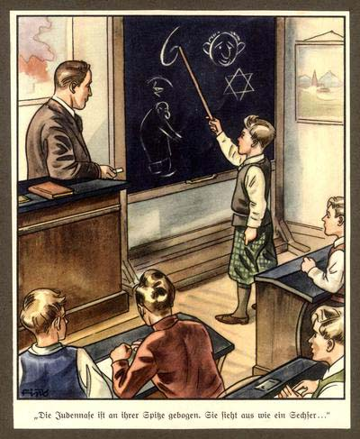
The Jewish Nose is Wide at the End and Looks Like the Number Six

Slide 20
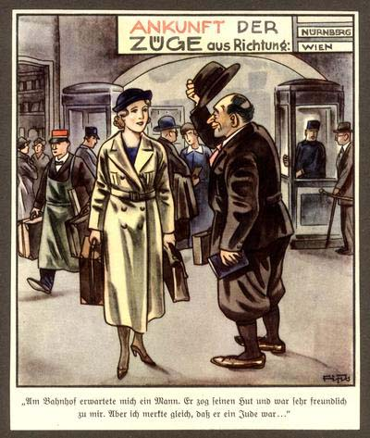
He was very friendly. But I immediately realized he was a Jew.

Slide 21
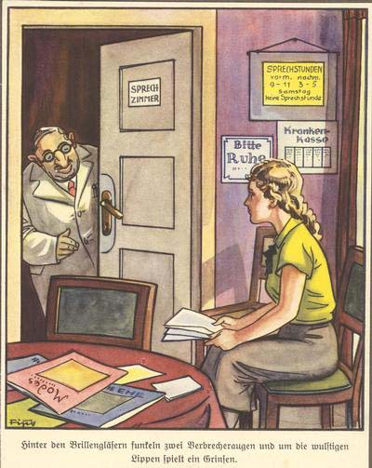
A Jew at an infirmary – Behind his glasses glare the eyes of a criminal.

Slide 22
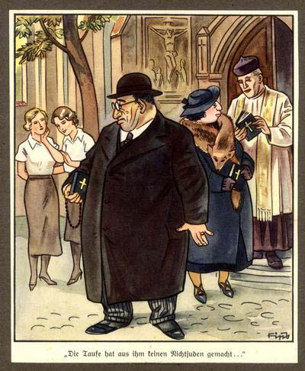
The Christians saying, “Even the baptizing didn’t make him non-Jewish”

Slide 23
ADL’s Pyramid of Hate
Record details from the posters you have seen in the appropriate space on the pyramid.
Where do you see scapegoating and stereotyping? (Level I)
Where do you see name calling? Ridiculing? Social avoidance? Social Exclusion? Belittling jokes?
(Level II)

Slide 24
Reflection of Propaganda
How would you characterize Nazi propaganda?
Why do you think that the majority of German people did not see Nazi propaganda as negative?
How can a person be tempted to believe in propaganda?
How did the dehumanization of Jews make them an easy target for abuse?

Slide 25
Jim Crow versus Nuremberg Laws
Your group is responsible for reviewing the information about Jim Crow and Nuremberg laws and determining how they compare and contrast.
Complete the row for the element assigned to you (personal relationships, business, education, etc.)
Your group will share findings as other groups add to their own chart.

