Slide 1
Macbeth 2: Fleance’s Triumph Please pick up your spiral as you enter.
Now for our next unit…

Slide 2
Just kidding
Our next unit focuses on Dystopian literature.
I like to say the novels are about sex, drugs, violence, and mind control. This is kind of a joke, but also fairly accurate.
These works involve societies that are completely different, yet eerily similar to some aspects of our own.

Slide 3
Today’s Agenda
Dystopian Literature Introduction:
Your own utopia and dystopia
Dystopias versus Utopias
Get your read on

Slide 4
My utopia and dystopia
Take a few minutes to jot down your ideas about the following prompts:
What would your perfect world look like?
Now, what would the opposite look like?

Slide 5
Utopias and Dystopias

Slide 6
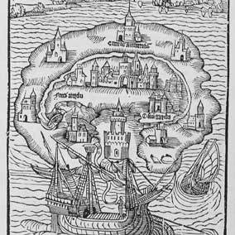
Utopia
Ou = No, not
Topos = Place
Optimistic vision of future society
Agrarian/Natural
Communistic/Socialistic
Religious/Spiritual

Slide 7
Real Attempts at Utopias
The Transcendentalists at Brook Farm
Massachusetts in the 1840s
Members tried to balance work and labor
Never financially profitable, but devastated by a fire that burned down their major structure
The Perfectionists at Oneida
Started in the late 1840’s in New York
Believed the Second Coming happened in the year 70 A.D. and thus perfection was possible
Group eventually disbanded and became the Oneida Silverware Company
Jonestown
Founded in South America by Jim Jones
In 1978, 909 people died by self-induced cyanide poisoning

Slide 8
Dystopias
Dys = bad, wrong Topos = place
Some common themes :
Subjection, destruction, or mastery of nature
Nature becomes barren or turns against humankind
Technological advances enslave humans or regiment their lives
Mandatory division of people in society into castes or groups with specialized functions
Collective loss of memory and history
State manipulation of humans
Dehumanization

Slide 9
Total Terror
The Effect on the Individual
No guarantees
Total submission and total sacrifice
Destruction of the very basis of social relations

Slide 10
Dystopias
Orwell’s 1984

Slide 11
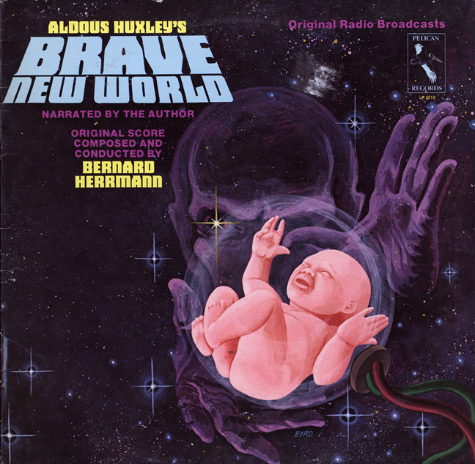
Dystopias
Huxley’s Brave New World

Slide 12
Dystopias
Bradbury’s Fahrenheit 451

Slide 13
MLA Work Cited Entry
Last name, First name. Title. Publisher, Publication date, Location.
Example:
Shelley, Mary. Frankenstein. Glencoe McGraw-Hill, 2000, New York.

Slide 14
Reading Day 1 Summary
In your spiral, set up a chart like this:
What is frightening about this society (Dystopian view) | What could be perceived as positive about this society (Utopian view)

Slide 15
Questions to Consider
Which aspects of this society are negative or frightening?
Which aspects seem positive or beneficial?
Which aspects do you see mirrored in your own ideas of a dystopian or utopian society?

