Slide 1
Monday, March 20 and Tuesday, March 21
Please pick up your spiral as you enter.

Slide 2
TODAY’S AGENDA
Do Now: Equality
Read “Harrison Bergeron”
Group Analysis of character and theme
Watch film version of “Bergeron”
SSR Time – next chunk of reading due Wed/Thur

Slide 3
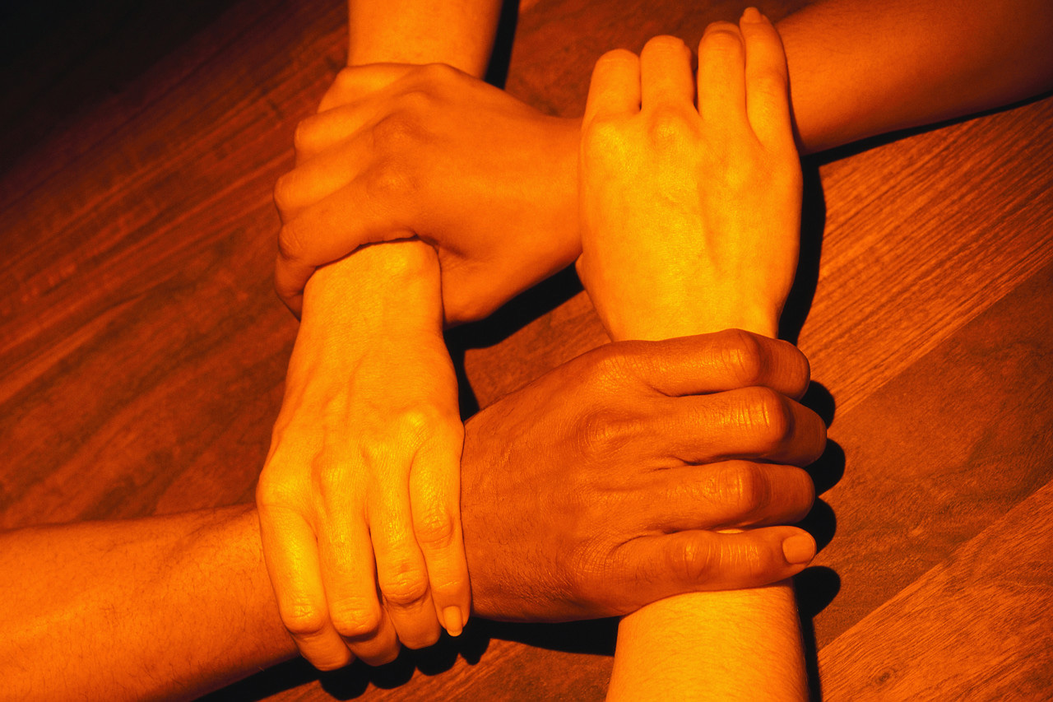
Equality
The Declaration of Independence assert that “all men are created equal.” Is that true? Explain.

Slide 4
Equality…
Why is it important that all members of a society are treated equally? Or, why do we think it’s important?

Slide 5
Equality…
Does our society treat all of our members of our society equally?
Provide examples of equality and inequality of our society.

Slide 6
Reflection on Dangers of Equality
Could we take it too far? Of course we can!...and did!

Slide 7
What would happen if…
Imagine a world where we made everyone truly equal in status, wealth, talent and intelligence?
What would that look like?
What problems would occur?
What might it fix or ameliorate in our society?

Slide 8
Read “Harrison Bergeron” and respond to the questions provided.
Questions are due by the end of class.

